Slide 1
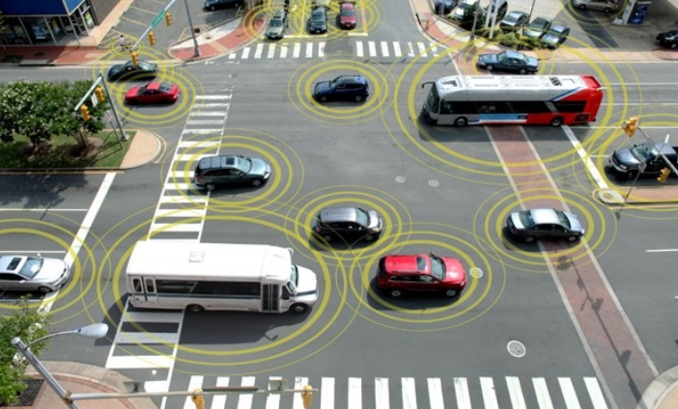


S.M.A.R.T TRAFFIC SYSTEM
By : MOKLET TEAM

Slide 2

Highlight
Project Background
Purpose
Description S M A R T Traffic System
Goal
Closing

Slide 3
Background
As we know that world oil reserves is depleted and cause world oil prices continue to rise.
Jakarta, as one of the Big city what has a big problem with traffic jam which contribute to the wasteful use of fuel.
So, with this SMART Traffic System, it can solve Jakarta traffic jam’s problem, using ERP (Electronic Road Pricing) system, used to increase fuel oil efficiency, that make Jakarta, Indonesia and world more Eco-friendly
Notes:
Seperti kita ketahui bahwa cadangan minyak dunia habis dan harga minyak menyebabkan dunia terus meningkat. Jakarta, sebagai salah satu kota besar yang memiliki masalah besar dengan kemacetan yang berkontribusi terhadap penggunaan boros bahan bakar. Jadi, dengan ini Sistem Lalu Lintas SMART, dapat memecahkan masalah kemacetan lalu lintas di Jakarta, dengan menggunakan ERP (Electronic Road Pricing) sistem, yang digunakan untuk meningkatkan efisiensi bahan bakar minyak, yang membuat Jakarta, Indonesia dan dunia yang lebih ramah lingkungan

Slide 4
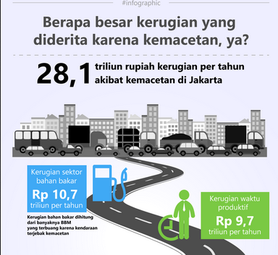
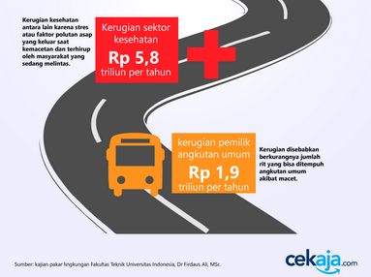
Background

Slide 5
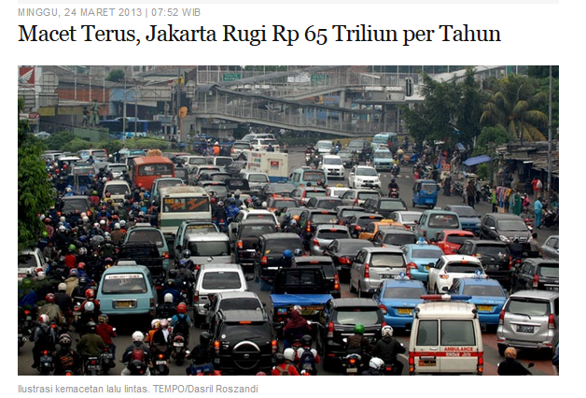
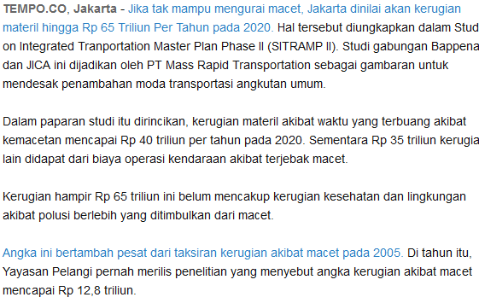
Background

Slide 6
SMART Traffic System’s Purpose
ERP Solution
Traffic jam analysis
Parking Solution
Lower Traffic Violation
Fuel Oil Efficiency
Eco Jakarta, Indonesia, World

Slide 7
Description S.M.A.R.T Traffic System
Specific
Measureable
Achievable
Realistic
Time Frame

Slide 8
System Diagrams

Slide 9




1
3
Send GPS Coordinate
to Main Server Database
Send GPS
Coordinate
2
4
GPS + GPRS Module
GPS + GPRS Module
GPS + GPRS Module
Main Server
5
Government Traffic Client
Personal
Traffic Client
Government Parking Client
Coorporate
Parking Client
Personal
Parking Client

Slide 10


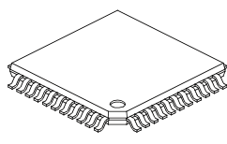
PARKING SYSTEM
Micro Controller
Parking
Server
Main
Server
Government Parking Client
Coorporate
Parking Client
Parking Sketch
Personal
Parking Client

Slide 11
Specific (1)
Jakarta Citizen, Jakarta Local Government, Police Department are involved with this system
This system will be accomplished if it has System developer, and support from The Government Policy and Police Policy Where is location?
The prototype will be deployed in Jakarta
Establish 7th July 2015

Slide 12
Specific (2)
New vehicle and connection cost are the constraints
It has some advantages, such as
ERP Solution
Traffic jam analysis
Parking Solution
Lower Traffic Violation
Fuel Oil Efficiency
Eco Jakarta, Indonesia, World
Police Officer operational cost down

Slide 13
Measureable
GPSID attach in 80% from 3.2 M cars in Jakarta (2.6 M units)
This project is has been achieved when in Application shows 2.6 M cars that has a unique GPSID and no major error in the app

Slide 14
Achievable
This system is said to be achieved when:
Government & citizen enjoy Jakarta’s traffic
Traffic Polices have easier job
Government use mapinfo for policy
Citizen use mapinfo for smart driving
Monetizing

Slide 15
Realistic
Perhaps the GPS system is very commonly used today, or perhaps the ERP system has been implemented in several countries that use RFID.
And we combine the two ideas to present more useful information for the traffic management system.

Slide 16
Time Frame
Now we are show you our prototype system
July 7th 2015 we can launch product
 | March | April | May | June | July
Prototype
Mockup
Pilot Project
Soft Launch
Grand Launch

Slide 17
Goal

Slide 18
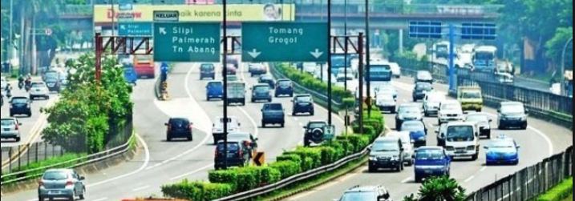
Quality
Increasing average road speed by about 20%
Decrease traffic about 13% from 17.523.967 to 15.245.851
Data collect from city who using ERP

Slide 19
Quality
No | Items | Radio | Camera | STS
1 | Data Accuracy | 40% | 80% | Up to 99%
2 | Coverage Area | 60% | 60% | Up to 99%
3 | Data Analysis | Sampling | Sampling | Real Time
4 | Duration Analysis | not yet | all time | all time
5 | Report | real time | Real Time | Real Time
6 | Report Simplicity | per part | huge data | simple data
7 | Counting Methode | nothing | estimation | total

Slide 20
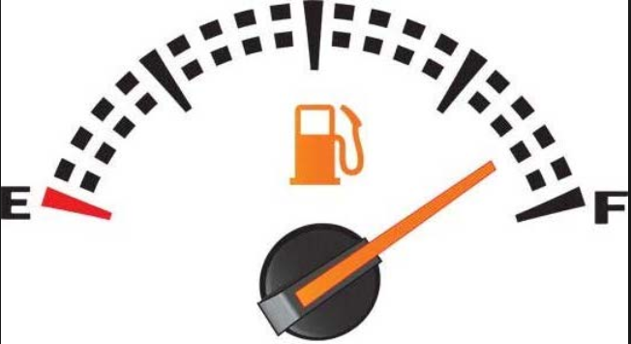
Cost-Benefit-Efficiency
Jakarta Fuel Consumption 9 M liter per day = Rp 68,4 B per day = Rp 24,966 T per year
ERP Efficiency 13% = Rp 3,245 T per year
You will get 50% profit at minimum per year

Slide 21
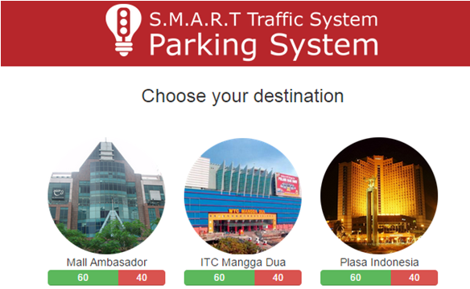
Delivery
App Interface User friendly
Useful Information Analytics
Increase Local Government Income
Eco-friendly

Slide 22
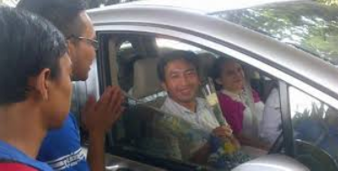
Safety
Lower traffic violation
Cost down traffic Police officer
Increase speed average become increase citizen satisfaction

Slide 23

Revenue
Decrease fuel consumption
Increase Government Income
High return investment (2 year Break Event Point)
Minimal ERP investment for local government

Slide 24
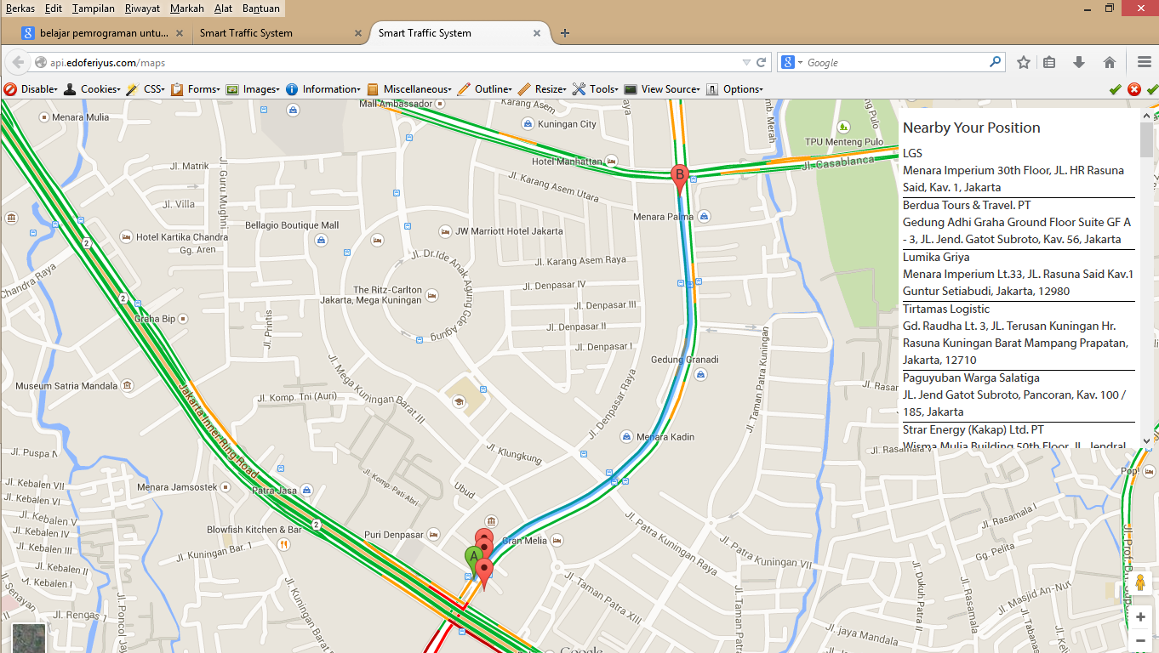
Mediatrac - API

Slide 25
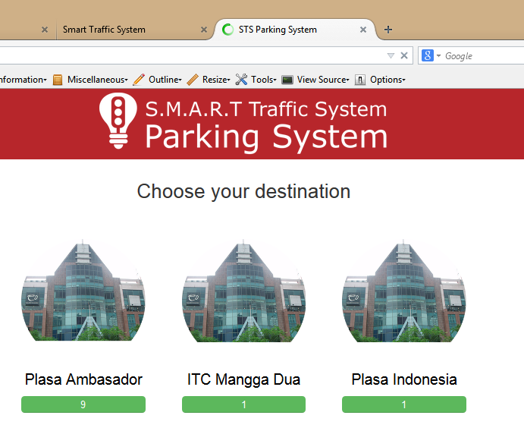
Parking System

Slide 26
THANK YOU

